Slide 1
Azure storage
Faggruppemøte .NET Core
Oslo
Espen Ekvang
02/04/13

Slide 2
AGENDA
Data storage on azure
Storage types
Table storage
Queue storage
Notes:
Gå gjennom alle typer storage på overordnet nivå

Slide 3
Data storage on azure
Access methods
handle failures
share hardware
pricing
Notes:
All of the storage offerings except local storage and Azure Drive are accessible from both inside and outside the Windows Azure Platform. Local storage and Azure Drive are only accessible from applications running on Windows Azure.

Slide 4
Storage types
Name | Purpose | Maximum size
Local storage | Per-instance temporary storage | 250 GB to 2TB
Blob storage | Large binary objects (video/audio) | 200GB to 2TB
Table storage | Structured data | 100TB
Queue storage | Inter-process messages | 100TB
SQL database | Relational database | 150 GB
Notes:
Local storage (http://msdn.microsoft.com/en-us/library/ee758708.aspx):
- Store temporary data on a per instance basis
- Fast access to physical storage on hardware instance your application is running
- Not durable because if an application is stopped and started on a different node, the local storage will not follow the application
Create application and use local storage to store something
Stop the application and start it again to verify that local storage is not necessary there
Represents a directory on the physical file system
Use standard .NET file IO with it since it is on the local file system
Can be configured to persists on simple recycle on web or worker role ( not restart on different hardware)
Blob storage
- Play a video stored on azure
Queue storage
- Similar to Microsoft message queue (MSMQ)
- Durable storage for passing messages between processes
SQL database
- Essentially SQL server on azure

Slide 5
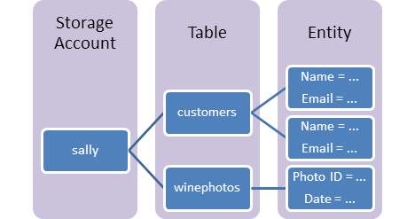
Table storage
Purpose | Maximum size
Structured data | 100TB
Store large amout of structured data
NOSQL datastore
Accessible from inside/outside windows azure
Notes:
http://www.windowsazure.com/en-us/develop/net/how-to-guides/table-services/?fb=nb-no
Table storage components:
Storage account < 100TB
Table, a single table can contain elements with different set of properties
Entity, set of properties similar to a database row
Property (name/value pair) each entity < 252 properties

Slide 6
Table storage - exercise
Clone repository https://github.com/espenekvang/AzureStorage.git
Open PersonCloud, very simple app that lists a number of persons
Store all persons in Azure Table Storage instead of in code as it is now
Hint http://www.windowsazure.com/en-us/develop/net/how-to-guides/table-services/?fb=nb-no

Slide 7
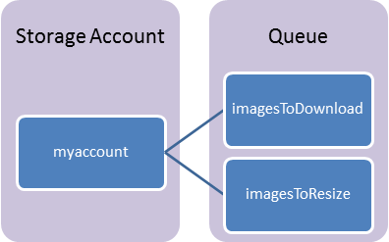
queue storage
Purpose | Maximum size
Inter-process messages | 100TB
asdf
Notes:
Create two processess – exercise is to send something from one process to another, and reply back. Gå gjennom Tables and Queues
Tables: http://www.windowsazure.com/en-us/develop/net/how-to-guides/table-services-v17/?fb=nb-no
Queues: http://www.windowsazure.com/en-us/develop/net/how-to-guides/queue-service-v17/?fb=nb-no

Slide 8
Queue storage - Exercise
http://www.windowsazure.com/en-us/develop/net/how-to-guides/queue-service/?fb=nb-no

Slide 9
Thanks
Espen Ekvang
espen.ekvang@bekk.no

